Slide 1

STUDENT MANAGEMENT SYSTEM
( Certificate Management )
PRANIL PATIL 20104121 SAHIL SHETTY 20104122 AKASH PATIL 20104075
SUSHANT WAGHMARE 20104113
Project Guide
Prof. Anagha Aher
Notes:
1

Slide 2
Content
Introduction
Objectives
Scope
Features / Functionality
Project Outcomes
Technology Stack
Block Diagram
Notes:
2

Slide 3
1. Introduction
Versatility of the Application
Problem Identified :
Student must browse multiple website to track their Certificates.
Institute must Request students to upload Certificates Via other platforms.
Solution Proposed :
This Software helps the student to put all their certificates in one place Where they can Add , Edit & Track there New as Well as old Certificates.
Notes:
3

Slide 4
2. Objectives
Certificates of different courses completed by them should be made available to the students as soon as possible.
This project should be of use to the students in future .
Students should have their certificates available in less time.
Certificate information of students from different departments for the institute should be easily available.
Notes:
4

Slide 5
3. Scope
Certificates of students from different faculties will be simply available for the institute.
All certificates of the student will be easily available for his resume .
Reduction human labour, paper and workload.
Help to track Certificates of all students.
Notes:
5

Slide 6
4. Feature /Functionality
Registration is quite simple admin has to register student using Moodle.id, Name.
Student can add their Institute certificates & Extra curriculum Certificates.
The portal Contains File replace functionality to replace wrong certificates.
In Data management student can Sort all their Certificates.
Notes:
6

Slide 7
5. Outcome of Project
The application that has been developed as an outcome of this project Can be used by all the project-oriented organization
Organizations Using the application can add admin functionality to the application.
The functionality would allow administrator to add, modify and remove the organized goal from the system.
Institute can track the Certificates of students from different Branches and can store them in sorted way.
Notes:
7

Slide 8


6. Technology Stack
Programming language : Java
Operating System: Windows 11
Development Environment : Visual Studio
Database : MySQL(PHPMYADMIN)
Local Host: Xampp server
Notes:
8

Slide 9
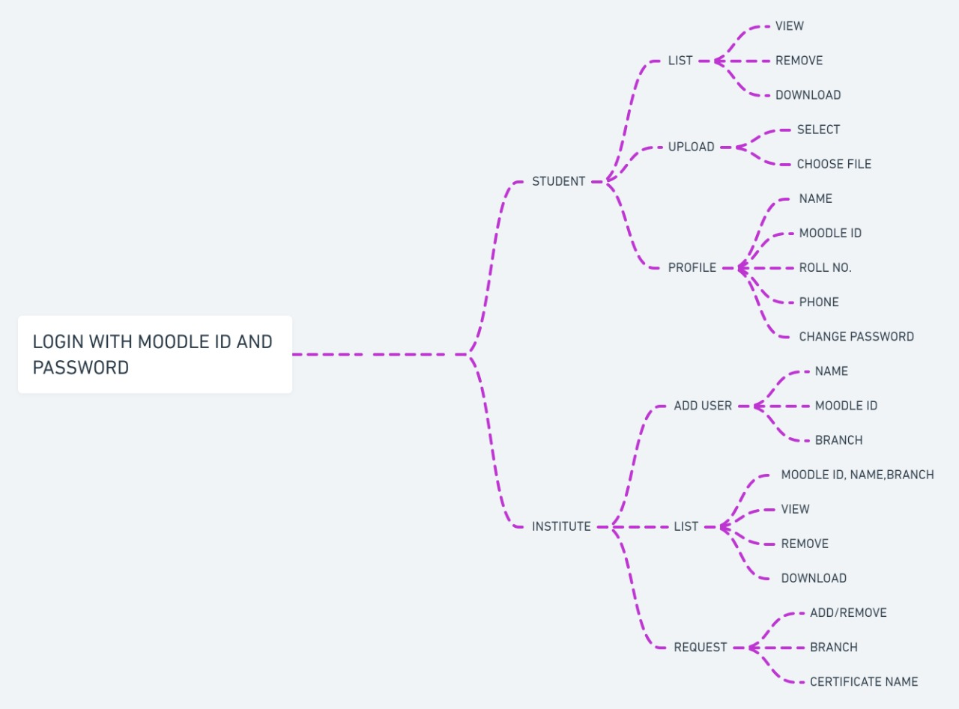
7. Block Diagram
Notes:
9

Slide 10
Thank You...!!
Notes:
10

